Slide 1



Customer Churn Analysis
Presented by Nur Ammar Ashraf.
Bootcamp Data Analytics | 20/7/2025

Slide 2


Project Objectives
This analysis aims to better understand customer churn by identifying patterns and data-backed strategies to improve customer retention.
Key Objectives:
Identify customer churn trends
Analyze the main causes of churn
Understand customer behavior and patterns
Provide data-driven retention strategies
Support business decisions to reduce churn effectively

Slide 3
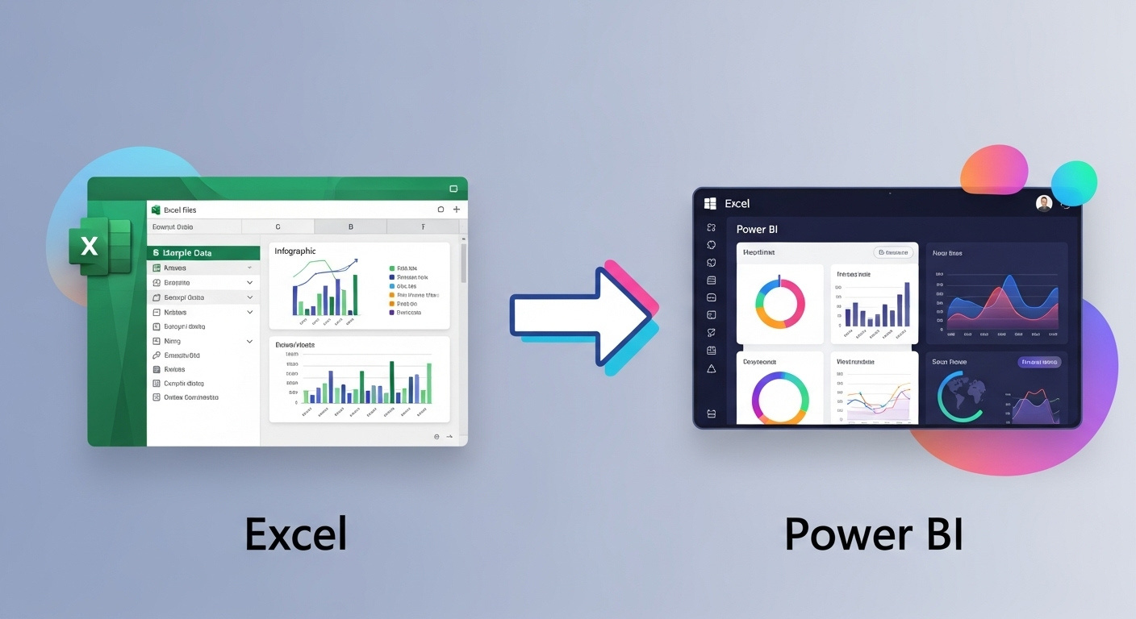
Method

Slide 4


Data Preparation Steps for Customer Churn Analysis
Before performing this analysis, the raw dataset has gone through a preparation and cleaning process. This ensures the data is accurate, consistent, and ready for reliable analysis. The steps below were performed using Power Query Editor in Power BI:
Set correct data types
Converted MonthlyCharges, TotalCharges, and tenure to Number type
Recode binary values for better readability
SeniorCitizen: 0 → "No", 1 → "Yes"
Handle missing values
Filtered null values in TotalCharges
Renamed columns for clarity
Example: tenure → Tenure (Months)
Note: No changes made to Churn as it is the target variable for churn analysis

Slide 5


Dashboard 1: Churn Rate Overview and Insights
Understanding these trends is crucial for implementing effective strategies to enhance customer satisfaction and reduce churn.

Slide 6
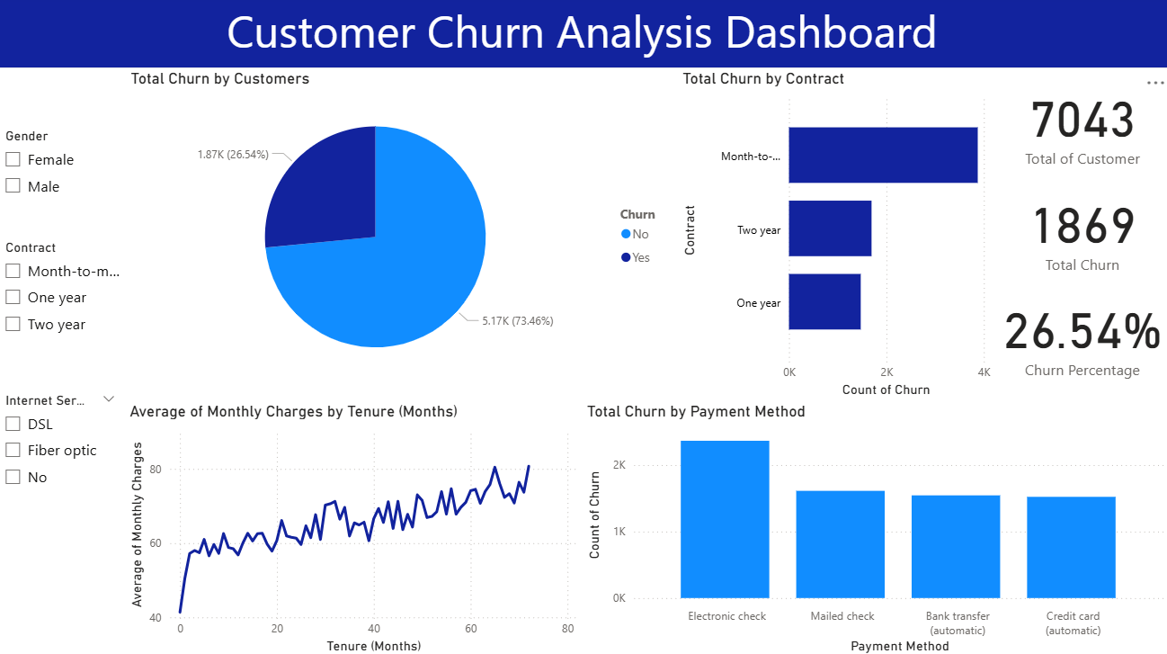

Slide 7

Dashboard 2: In-Depth Diagnostic Insights
This dashboard provides a detailed examination of the factors contributing to customer churn. By drilling down into specific demographics and service categories, we can identify targeted areas for improvement and strategically address customer retention efforts. Insights gained here will guide our recommendations moving forward.

Slide 8
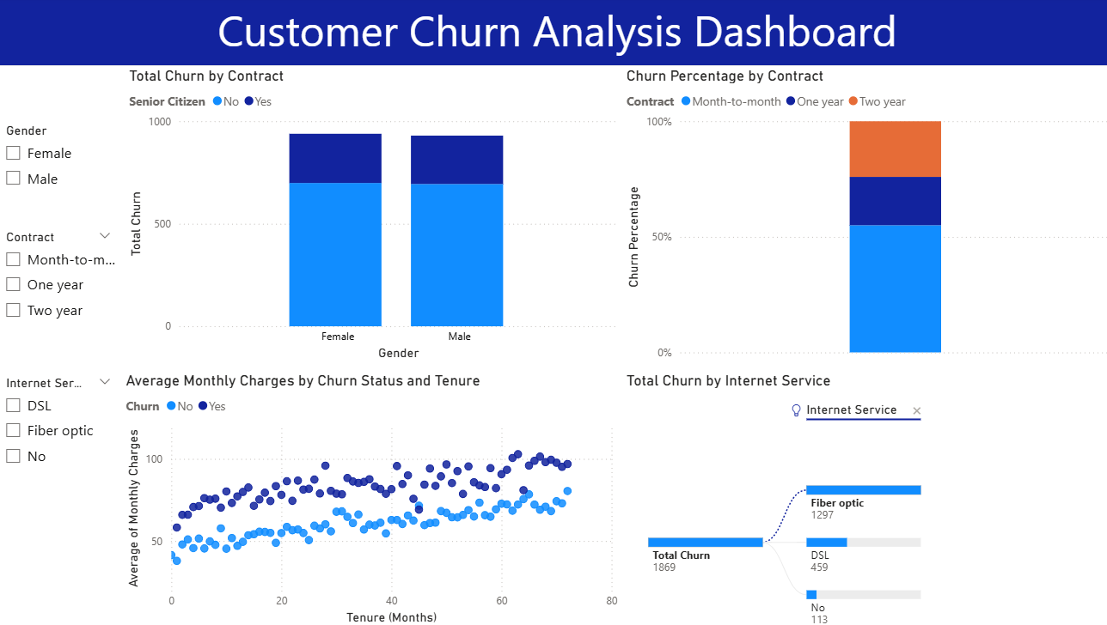

Slide 9


Key Findings

Slide 10
Account Information
Month-to-month contracts = highest churn.
Long-term contracts (1–2 years) = lower churn.
Consistent churn pattern by contract type across customer base.
Customer Demographics
Gender is balanced — minimal impact on churn.
Non-senior citizens churn more than seniors.
Churn trends stable across time.
Service Usage
Fiber optic users = largest segment & highest churn.
These users also pay higher monthly charges.
Indicates a mismatch between price and perceived value.
No-internet users churn the least.
Mid-tenure fiber users (10–50 months) show high churn.

Slide 11
Retention Strategy

Slide 12
Issue | Key Insight | Recommended Action | Expected Outcome
Contract Duration | Month-to-month users churn are the most. | Offer incentives to move to 12/24-month contracts. | Lock-in customers, reduce churn.
Fiber Optic Users | 69% of churners use fiber & pay higher bills. | Improve service, loyalty perks, satisfaction survey. | Retain high-value customers.
Payment Method | Electronic check users churn the most. | Promote auto-pay methods via bonuses. | Prevent payment-related churns.

Slide 13
Issue | Key Insight | Recommended Action | Expected Outcome
Tenure & Monthly Charges | Mid-tenure (10–50 months), high-payers are likely to churn. | Targeted offers + retention campaigns for this group. | Save high-revenue users.
Predictive Analytics | Churn is predictable using several customer attributes. | Develop churn-risk scoring model + automate retention actions. | Reduce churn with early intervention.

Slide 14

📌 Conclusion
This churn analysis helps us better understand how customers behave and use our services. It shows which areas need improvement and where we have the chance to keep more customers. Going forward, using data to guide our decisions and reaching out to customers early will be important to reduce churn and build stronger, long-lasting relationships.

Slide 15



Thank you for your attention and participation
Q&A SESSION

